Slide 1
OUTER CONTINENTAL SHELF
EXPLORATION , PRODUCTION AND THE LANDMAN’S ROLE
2013

Slide 2

TABLE OF CONTENTS
I. Disclaimer
What is the Outer Continental Shelf (OSC)?
Why Invest in the OCS?
Exploration on the OCS
Production Operations on the OCS
Regulation and The U.S. Government
The Role of the Landman
Fruit of the Labor

Slide 3
I. DISCLAIMER
The views expressed in this presentation reflect those of various members of the OCS Advisory Board (“OCSAB”). They should not be considered the views of any particular member of the OCSAB , the company for which a member is employed or such company’s subsidiaries or affiliates (“Companies”). This presentation is being made available with the understanding that neither the OCSAB nor the Companies are rendering legal, accounting or other professional services or advice.
This presentation is made available merely as a courtesy and an educational aid. In no event does any member of the OCSAB, the OCSAB or the Companies warrant the accuracy of the information contained herein.

Slide 4
II.
What is the
Outer Continental Shelf?

Slide 5
Submerged Lands Act of 1953
In 1953, Congress passed the Submerged Lands Act of 1953 which granted ownership to the coastal states of all natural resources lying within three miles of their coast (three marine leagues for Texas and the gulf coast side of Florida, which equal approximately nine miles).

Slide 6
Outer Continental Shelf Lands Act of 1953
Also in 1953, Congress passed the OCSLA which defined the OCS as all submerged lands more than three miles from the state coastal boundaries with the 9 mile exception provided for Texas and Florida. This act empowers the U.S. Department of the Interior to issue oil and gas leases through the Bureau of Ocean Energy Management (BOEM) - formerly the Minerals Management Service (MMS).

Slide 7
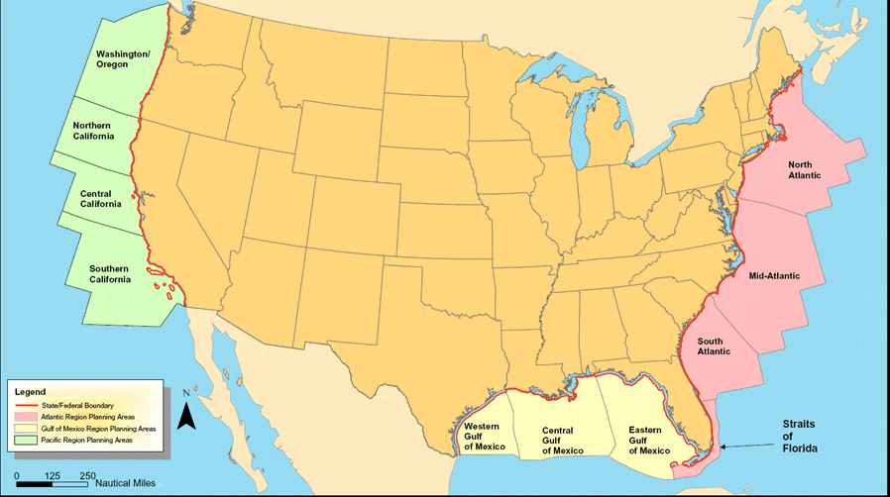
Map of the Lower 48 and the
Outer Continental Shelf

Slide 8
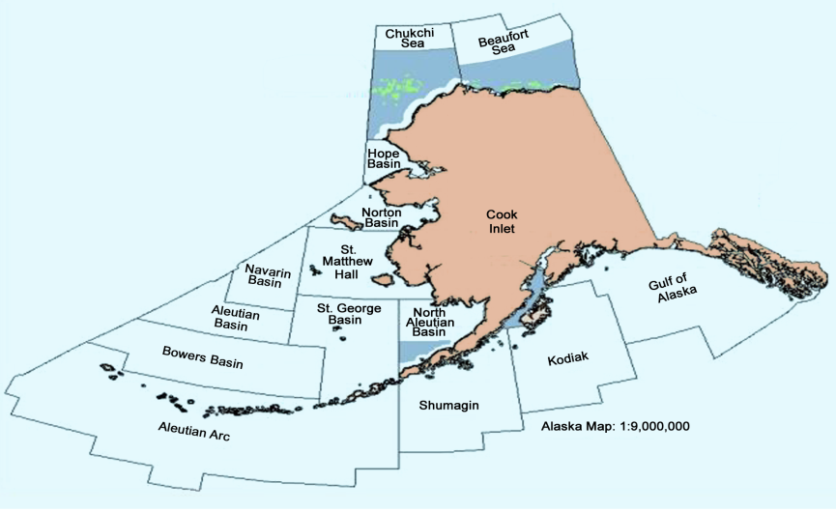
Outer Continental Shelf -Alaska Planning Area

Slide 9
III.
Why Invest in the
Outer Continental Shelf?

Slide 10
The OCS: A Place for Production
When Willie Sutton, famous bank robber, was asked why he robbed banks, he replied “because that's where the money is.” In fiscal year 2009 alone, revenue and royalty from OCS production totaled over $5.8 billion dollars.
The Gulf of Mexico OCS is commonly recognized as one of the most prolific hydrocarbon producing basins in the world.
The OCS also contains millions of acres of mineral resources that have yet to be explored.
Through modern 3D seismic data and sophisticated technology, explorers are now able to drill and produce hydrocarbons in water depths exceeding 10,000’ and drilling depths 30,000’ below the ocean floor unlocking vast resource potential.

Slide 11
In 2011, the OCS provided approximately 26% of the oil and 8% of the natural gas produced in the United States.
Without the OCS contribution to the US national production, the United States would need to import more oil and gas from foreign sources.
Currently, the US imports approximately 45% of its oil from foreign sources.

Slide 12
    Western Gulf of Mexico
      6,514 blocks 35,905,730 acres
    Central Gulf of Mexico
      9,109 blocks 47,780,858 acres
    Eastern Gulf of Mexico
      13,457 blocks 75,585,244 acres

Slide 13
OCS Oil Production*
As a Percentage of Total US Production
Year | OCS (bbls) | Total US (bbls) | OCS % of Total US Production
1960 | 40,608,049 | 2,574,933,000 | 01.58%
1970 | 354,174,675 | 3,517,450,000 | 10.07%
1980 | 274,729,436 | 3,137,905,000 | 08.76%
1990 | 304,394,527 | 2,684,575,000 | 11.34%
2000 | 559,060,599 | 2,095,920,000 | 26.67%
2007 | 492,329,179 | 1,836,915,120 | 26.80%
* Includes Condensate Production

Slide 14
Crude Oil & Condensate Production
OCS vs. All Other Domestic*

Slide 15
OCS Gas Production
As a Percentage of Total US Production
Year | OCS (Mcf) | Total US (Mcf) | OCS % of Total US Production
1960 | 281,487,136 | 12,771,038,000 | 02.20 %
1970 | 2,463,705,637 | 21,920,642,000 | 11.24%
1980 | 4,866,996,966 | 20,305,000,000 | 23.97%
1990 | 5,055,421,377 | 18,744,000,000 | 26.97%
2000 | 5,033,739,377 | 20,289,000,000 | 24.81%
2007 | 2,860,083,010 | 20,149,000,000 | 14.91%

Slide 16
Natural Gas Production
OCS vs. All Other Domestic*

Slide 17
IV.
Exploration on the
Outer Continental Shelf

Slide 18
Acquiring the Rights to Explore
The right to explore and drill on the OCS can be acquired through many different methods, including:
    OCS Lease Sale Participation
    Joint Venture
    Farmout
    Purchase and Sale
    Prospect Swaps

Slide 19
An OCS block will generally consist of either
5,000 acres (Louisiana Shelf)
or
5,760 acres (all other OCS areas)

Slide 20
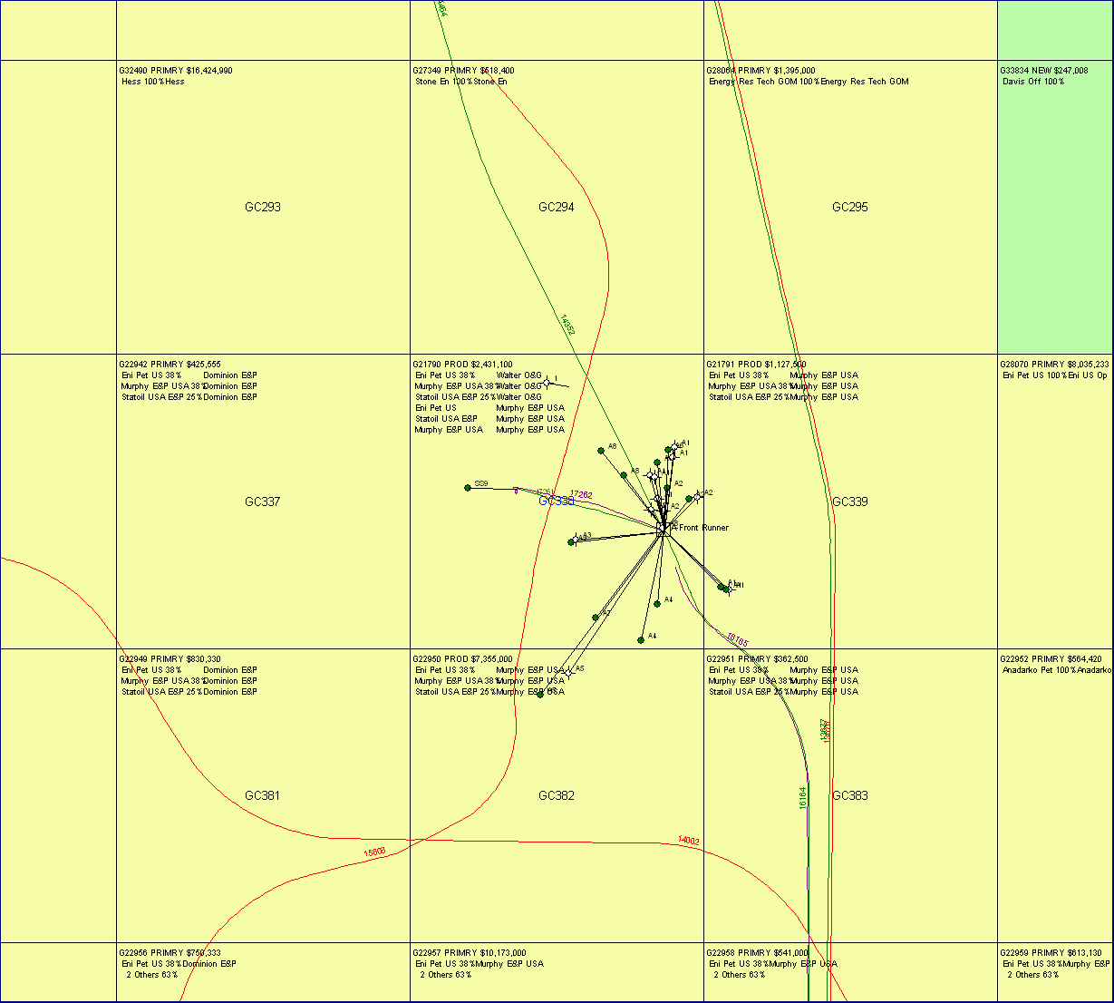
Example of OCS Producing Block

Slide 21
Who can own an OCS lease?
The right to own an OCS lease is restricted to:
  U.S. Citizens;
  Resident Aliens;
  U.S. Corporations;
  Associations of U.S. citizens, Resident Aliens or U.S. Corporations.

Slide 22
Bonding
A lease owner must secure performance bonds in order to demonstrate to the BOEM that it is capable of meeting financial obligations imposed by the lease. Types of bonds required include:
Lease Bond: Bond amount of (i) $50,000 per lease or (ii) $300,000 area
wide bond covering all leases. Alternatively, bond amounts equal to the
Exploration and Development bonds below will meet Lease Bond obligation.
Exploration Bond: Bond amount of $200,000 in order to conduct
exploration activities. If lessee has area wide bond of $1MM, then
excused from posting an Exploration Bond.
Development Bond: Bond amount of $500,000 in order to conduct
development and production activities. If lessee has area wide bond of
$3MM, then excused from posting a Development Bond.

Slide 23
Proof of Oil Spill Financial Responsibility (OSFR)
Congress passed the Oil Pollution Act of 1990, which requires a lessee to pay for all of the containment and removal expenses of an offshore oil spill originating from a well, platform or drilling rig. However, consequential damages resulting from the spill are capped at $75,000,000 per incident. The cap does not apply if the spill is a result of gross negligence or willful misconduct.
OPA 1990 and the regulations enacted by the Department of the Interior as a result of OPA 1990 requires lessees to provide proof of financial responsibility between the amounts of $35,000,000 and $150,000,000 depending on the estimated ‘worst case discharge’ oil spill volume from lessees’ wells or operations.

Slide 24
The OCS Lease Sale

Slide 25
Leasing the OCS,
The 5 Year Program
The ‘5 Year Program’ is a schedule of OCS lease sales indicating size and location of the future sales within that 5 year period. The Secretary of the Department of the Interior determines the size and location which best meets the nations energy needs for the five year period following its approval.
The public has the opportunity to comment on the proposed 5 Year Program before it is enacted.
Past 5 Year Programs include 92’-97 Program; 97’-02’ Program; and the 07’-12’ Program.
Current 5 Year Program is 2012’-2017’.

Slide 26
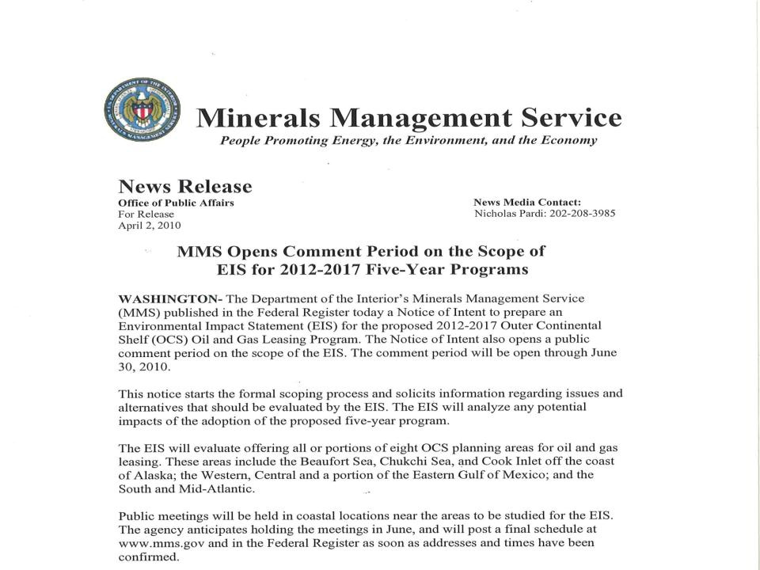

Slide 27
OCS Lease Sale Preparation
Landmen play a critical role in the participation in an OCS lease sale.
The Landman’s responsibilities include prospecting for lease sale opportunities, the formation and documentation of lease sale partnerships, bid meeting preparation and execution, ensuring compliance with bidding rules and regulations, including bid forms, bid amount generation and ascertaining competition levels.

Slide 28
The Gulf of Mexico OCS Lease Sale
  All unleased blocks within the sale area are available for leasing under a sealed bid process. Sealed bids are delivered to the BOEM office in New Orleans no later than 10:00am of the day preceding the date of the lease sale.
  The terms and conditions of the lease, including lessor royalty, rentals, and term are predetermined by the U.S. Government, with only the cash bonus amount to be determined by the bidding party.
  Bidders may submit individual bids or bid with one or more companies.
  Bids are evaluated solely on the highest cash bonus offered.

Slide 29
The Gulf of Mexico OCS Lease Sale:
Evaluation of High Bids
    The BOEM is not obligated to accept a high bid for a block.
    All high bids are first evaluated for compliance with bidding rules. In order to ensure the U.S. Government receives fair market value in exchange for the leasing rights, the BOEM conducts a two phase review of the high bids.

Slide 30
The Gulf of Mexico OCS Lease Sale:
Evaluation of High Bids
The BOEM will first conduct a Phase I evaluation and will award leases for those blocks where:
  competitive market forces can be relied upon to ensure receipt of fair market value (generally, 3 or more competitive bids on a block); or
  2) the BOEM evaluation does not indicate an economically viable prospect.
All blocks not awarded in Phase I are deferred to Phase II. In Phase II, the BOEM will perform its own economic valuation and determine if the high bid represents fair market value.
The BOEM will reject on average 5% of the high bids.

Slide 31
Gulf of Mexico Lease Form and
Lease Terms

Slide 32
UNITED STATES
DEPARTMENT OF THE INTERIOR
MINERALS MANAGEMENT SERVICE
OIL AND GAS LEASE OF
SUBMERGED LANDS UNDER THE
OUTER CONTINENTAL SHELF LANDS ACT
This form does not constitute an information collection as
Defined by 44 U.S. C. 3502 and therefore does not require
approval by the Office of Management and Budget.
Office New Orleans, LA | Serial Number OCS-G 33115
Cash Bonus $1,230,200.00 | Rental Rate per acre, hectare or fraction thereof See Addendum
Minimum royalty rate per acre, hectare or fraction thereof $7.00 per acre | Royalty Rate 18 ¾ percent Profit share rate
Bonus
Royalty
Rent
Term
This lease is effective as of JUN 01 2009 (hereinafter called the “Effective Date”) and shall continue for an initial period of five years (hereinafter called the “Initial Period”) by and between the United States of America (hereinafter called the “Lessor”), by the Regional Director, Gulf of Mexico OCS Region, Minerals Management Service, its authorized officer, and
Walter Oil & Gas Corporation 33.33%
Mariner Energy, Inc. 66.67%
(hereinafter called the “Lessee”). In consideration of any cash payment heretofore made by the Lessee to the Lessor and in consideration of the promises, terms, conditions, and covenants contained herein, including the Stipulation(s) numbered 3 and 8 attached hereto, the Lessee and Lessor agree as follows:
Sec. 1. Statutes and Regulations. This leases is issued pursuant to the Outer Continental Shelf Lands Act of August 7, 1953. The lease is issued subject to the Act; all reulations issued pursuant to the Act and in existence upon the Effective Date of this lease.
Sec. 2. Rights of Lessee. The Lessor hereby grants and leases to the Lessee the exclusive right and privilege to drill for , develop, and produce oil and gas resources in the submerged lands of the Outer Continental Shelf containing approximately 5,000.000000 acres described as follows:
All of Block 318, South Timbalier Area, South Addition, OCS Leasing Map, Louisiana Map No. 6A
Lessee
Legal Description

Slide 33
OCS Lease Duration
The BOEM establishes the lease terms for each lease sale. Lease terms historically contained primary terms between 5 and 10 years depending on water depth. Historical Lease Terms were:
5 year term – water depths less than 400 meters
8 year term – water depths from 400 meters to 800 meters
10 year term – water depths greater than 800 meters
However, effective for Central Sale 213, held March 17, 2010, the BOEM reduced the primary term to 7 years for leases in water depths of 800 meters to less than 1600 meters.

Slide 34
OCS Lease Duration
A lease will expire if oil or gas production is not established or a Suspension of Operations (SOO) or Production (SOP) is not granted prior to the end of the primary term.
SOP: Is appropriate when the lease is past its primary term and the lease has no producing wells and an operator has a well(s) that it plans to place on production.
SOO: Is appropriate when lessee has signed a rig contract and has a drilling operation scheduled before lease expiration but due to unforeseen and unavoidable circumstances, the operation is delayed past the primary term.
A lease will remain in effect until production in paying quantities ceases and there are no further operations on the lease.

Slide 35
OCS Lease
Delay Rentals and Minimum Royalties
Prior to the establishment of production, delay rentals are due on the anniversary date of the lease. After production is established, the royalties payable to the U.S. Government must meet a certain amount each year, otherwise a minimum royalty payment is due. The rental and minimum royalty amounts are established by the BOEM prior to each lease sale.

Slide 36
OCS Lease Royalty Amounts
The BOEM establishes the royalty percentage for each lease sale. Royalty amounts historically were 16.66667% for water depths up to 400 meters and 12.5% in water depths 400 meters or greater. Effective with Western Sale 204, held August, 2007, the royalty rate was increased to 16.66667% for all leases in all water depths. Then effective with Central Sale 206 held on March, 2008, royalty rates were increased to 18.75% for all leases in all water depths.

Slide 37
Gulf Of Mexico OCS
Royalty Revenue Sharing
The Gulf of Mexico Energy Security Act of 2006 established revenue sharing with certain Gulf coast states (Alabama, Louisiana, Mississippi and Texas).
From Fiscal Year 2007 through Fiscal Year 2016, 37.5% of all revenue including bonus bids, rentals and production royalty will be shared among the four States from new leases in part of the Eastern Gulf and the Central Gulf.
There is a cap of $500 million for qualified OCS revenues shared beyond 2016. From Fiscal Year 2017 and beyond, the four States will share 37.5% of revenues from all Gulf of Mexico leases issued after December 20, 2006.
Revenue sharing funds are required to be used for coastal conservation, restoration and hurricane protection.

Slide 38
Other OCS Lease Provisions
The lease form contains the basic lease terms. The Lessee is also subject to all regulations issued pursuant to the 1953 OCS Lands Act, as amended, and other applicable statutes and regulations governing the drilling, developing and operating of federal OCS leases.

Slide 39
Termination of OCS Leases
An OCS Lease can terminate in one of three ways:
Expire (End of Primary Term, or cessation of production, SOO or SOP expiration)
Surrender (Anytime during Life of Lease)
Terminate (Automatic pursuant to the terms of the lease or violation of lease terms)

Slide 40
Final Lease Obligations
One Year After Lease Termination To:
1) Plug all Wells
  2) Abandon and Remove all Platforms
  3) Clear the Seafloor
Pay all amount due
(Royalties, Rentals, Fines & Penalties)
Lessee may be subject to civil penalty and, in certain cases, criminal liability for failure to perform obligations .

Slide 41
V.
Production Operations
on the OCS

Slide 42
Major Milestones Required to Produce
Oil and Gas on the OCS
Once a discovery is made and a well is completed, the investment of time and resources has only just begun. First production is still many months and even years away.
Steps required to reach first production vary depending on water depth and depth of the well but generally, the operator must:
Evaluate production rates and flow assurances to ensure the investment is justified;
Evaluate Market options into which the oil and gas will be sold;
Select Platform option, either set own platform or tie the well back to an existing platform;
Design and Fabricate Platform, Pipelines and Production Equipment;
Install Platform, Pipeline and Production Equipment and tie-in the Well(s)
Turn on the well(s)

Slide 43
Downstream Commercial Agreements To Be Negotiated Before First Production
Various types of downstream contracts and agreements to be negotiated prior to the commencement of production include, but are not limited to:
Production Handling Agreements;
Oil and Gas Transportation Agreement ;
Oil and Gas Marketing Agreements;
Oil and Gas Sales Agreements;
Lease Dedication Agreements (if helpful to secure better sales price);
Onshore Oil and Gas Processing Agreement ;
Retrograde Agreement with Pipeline
(accounting for gas that condensates to liquid in a pipeline);
Condensate Separation and Stabilization Agreement
(provides for the separation of gas and condensate on the beach);
Dehydration Agreement ;
Facilities Agreement
(allowing for pipeline interconnect with transportation line)

Slide 44
VI.
Regulation and The U.S. Government

Slide 45
Regulation and The U.S. Government
The Lease itself does not grant all rights necessary to conduct oil and gas operations. The lessee must also secure numerous permits and approvals before, during and after the conduct of operations, including but not limited to:
Exploration Plan (EP) (BOEM issued)
Discharge Permit (NPDES) (EPA issued)
Application for Permit to Drill (APD) (BOEM issued)
Development Plan (DP or DOCD) (BOEM issued)
Coastal Zone Management (CZM) (issued by offsetting State)
Deepwater Operating Plan (or subsea wells) (DWOP)(BOEM issued)
Structure Permit (for platform wells) (BOEM issued)
Pipeline Permits (BOEM issued)
Surface Comingling Permits (BOEM issued)

Slide 46
5 Year Plan to First Production:
The US Government Is Involved!

Slide 47
Key Contracts and Regulations
Governing OCS Activities
Lease
Congress’ Laws Governing OCS Activities Are Codified In The Code of Federal Regulations, namely:
    30 CFR 250 – Regulating OCS Operations
    30 CFR 256 – Regulating OCS Leasing Activities
Information to Lessees and Operators (ITLs) issued by the BOEM – ‘FYI’ notices
Notice to Lessees and Operators (NTLs) issued by the BOEM – clarification and interpretation of existing regulations

Slide 48
Government Agencies, Laws and Regulations
DEPARTMENT OF THE INTERIOR
BOEM (Bureau of Ocean Energy Management)
BSEE (Bureau of Safety and Environmental Enforcement)
ONRR (Offices of Natural Resources Revenue)
Code of Federal Regulations

Slide 49
BOEM
The Bureau of Ocean Energy Management (BOEM) manages the exploration and development of the
nation's offshore resources. It seeks to appropriately balance economic development, energy
independence, and environmental protection through oil and gas leases, renewable energy development
and environmental reviews and studies.
Key functions of BOEM include:
The Office of Strategic Resources, which is responsible for the development of the Five Year Outer Continental Shelf (OCS)Oil and Natural Gas Leasing Program, oversees assessments of the oil, gas and other mineral resource potential of the OCS, inventories oil and gas reserves and develops production projections, and conducts economic evaluations that ensure the receipt of fair market value by U.S. taxpayers for OCS leases.
BOEM handles the actual Oil and Gas Lease Sales, along with Sand and Gravel negotiated agreements and official maps and GIS data.
BOEM is responsible for offshore Renewable Energy Programs. The Renewable Energy Program grants leases, easements, and rights-of-way for orderly, safe, and environmentally responsible renewable energy development activities.
BOEM’s Office of Environmental Programs conducts environmental reviews, including National Environmental Policy Act (NEPA) analyses and compliance documents for each major stage of energy development planning. These analyses inform the bureau’s decisions on the Five Year Program, and conventional and renewable energy leasing and development activities. Additionally, BOEM’s scientists conduct and oversee environmental studies to inform policy decisions relating to the management of energy and marine mineral resources on the OCS.
BOEM is supported by three regional offices in New Orleans, La., Camarillo, Calif., and Anchorage, Alaska. The regional offices manage oil and gas resource evaluations, environmental studies and assessments, leasing activities including the review of Exploration Plans and Development Operations and Coordination Documents, fair market value determinations, and geological and geophysical permitting.

Slide 50
BSEE
The BSEE works to promote safety, protect the environment, and conserve resources offshore through vigorous regulatory
oversight and enforcement.
Key functions of BSEE
The Offshore Regulatory Program develops standards and regulations to enhance operational safety and environmental protection for the exploration and development of offshore oil and natural gas on the U.S. Outer Continental Shelf (OCS).
The Oil Spill Response division is responsible for developing standards and guidelines for offshore operators’ Oil Spill Response Plans (OSRP) through internal and external reviews of industry OSRPs to ensure compliance with regulatory requirements and coordination of oil spill drill activities. It also plays a critical role in the review and creation of policy, guidance, direction and oversight of activities related to the agency’s oil spill response. The division oversees the Unannounced Oil Spill Drill program and works closely with sister agencies such as the U.S. Coast Guard and Environmental Protection Agency to continually enhance response technologies and capabilities.
The newly created Environmental Compliance Division is a first in the federal offshore energy regulatory program. This Division will provide sustained regulatory oversight that is focused on compliance by operators with all applicable environmental regulations, as well as making sure that operators keep the promises they make at the time they obtain their leases, submit their plans and apply for their permits.
BSEE is supported by three regional offices: New Orleans, La., Camarillo, Calif. and Anchorage, Alaska. The regional offices are responsible for reviewing Applications for Permit to Drill to ensure all of the recently implemented enhanced safety requirements are met and for conducting inspections of drilling rigs and production platforms using multi-person, multi-discipline inspection teams. BSEE’s inspectors issue Incidents of Non-Compliance and have the authority to fine companies through Civil Penalties for regulatory infractions. Regional and field operations personnel also investigate accidents and incidents.
BSEE operates the National Training Center with specially developed curriculum focusing on keeping our experienced inspectors current on new technologies and processes and ensuring that our new inspectors are given the proper foundation for carrying out their duties rigorously and effectively. The bureau also operates Ohmsett, the National Oil Spill Response Research and Renewable Energy Test Facility in Leonardo, N.J.

Slide 51
ONRR
The Office of Natural Resources Revenue (ONRR) has its roots within the U.S. Geological Survey (USGS) Regulations of 1936, which provided that the Secretary of the Department of the Interior (DOI) had the discretion to determine value for royalty purposes. In June 1981, President Reagan authorized the creation of the “Linowes Commission” to examine the fiscal accountability of the nation’s energy resources. In January 1982, the Minerals Management Service (MMS) was created within DOI from the Conservation Division of the USGS to improve management of Federal leasing revenues. There were two operational programs within MMS: Offshore Energy and Minerals Management, and the Minerals Revenue Management (MRM) program.
In May 2010, Interior Secretary Ken Salazar issued Secretarial Order No. 3299 separating the MMS responsibilities into three distinct organizations, one of which was ONRR. Issued in June 2010, Secretarial Order No. 3302 formally eliminated the former MMS and created the Bureau of Ocean Energy Management, Regulation and Enforcement (BOEMRE). Effective October 1, 2010, the functions of MRM officially transferred to ONRR, reporting to the Assistant Secretary for Policy, Management and Budget.
ONRR is responsible for the management of revenues associated with federal offshore and federal and American Indian onshore mineral leases, as well as revenues received as a result of offshore renewable energy efforts. This revenue management effort is one of the federal government’s greatest sources of non-tax revenues.
ONRR is comprised of three program areas including Asset Management, Audit and Compliance Management, and Financial and Program Management. Each year, ONRR achieves optimal value by ensuring that all natural resources revenues are efficiently and accurately collected and disbursed to recipients in a timely manner. The ONRR collects and disburses approximately $10 billion in annual revenues to the U.S. Treasury, five Federal agencies, 38 states, 41 American Indian Tribes, and about 30,000 individual Indian mineral owners.

Slide 52
Code of Federal Regulations
The Code of Federal Regulations (CFR) annual edition is the codification of the general and permanent rules published in the Federal Register by the departments and agencies of the Federal Government.
It is divided into 50 titles that represent broad areas subject to Federal regulation.
The 50 subject matter titles contain one or more individual volumes, which are updated once each calendar year, on a staggered basis.
The annual update cycle is as follows: titles 1-16 are revised as of January 1; titles 17-27 are revised as of April 1; titles 28-41 are revised as of July 1; and titles 42-50 are revised as of October 1.
Each title is divided into chapters, which usually bear the name of the issuing agency. Each chapter is further subdivided into parts that cover specific regulatory areas. Large parts may be subdivided into subparts. All parts are organized in sections, and most citations to the CFR refer to material at the section level.

Slide 53
Government Agencies, Laws and Regulations
OTHER LAWS INVOLVED IN OCS
NATIONAL ENVIRONMENTAL POLICY ACT
ENDANGERED SPECIES ACT OF 1973
COASTAL ZONE MANAGEMENT ACT
FEDERAL WATER POLLUTION CONTROL ACT
CLEAN AIR ACT
MARINE MAMMAL PROTECTION ACT OF 1972
PORTS AND WATERWAYS SAFETY ACT
NATIONAL HISTORIC PRESERVATION ACT
NATURAL GAS POLICY ACT
MARINE POLLUTION RESEARCH AND CONTROL
ACT OF 1987
OCCUPATIONAL SAFETY AND HEALTH ACT
OIL POLLUTION ACT OF 1990
NATIONAL FISHING ENHANCEMENT ACT OF 1984
RIVERS AND HARBORS OF 1899
COASTAL BARRIER RESOURCES ACT OF 1982
NATIONAL OCEAN POLLUTION ACT OF 1978
OTHER AGENCIES INVOLVED IN OCS
U.S. COAST GUARD
DEPARTMENT OF DEFENSE
CORPS OF ENGINEERS
U.S. AIR FORCE
DEPARTMENT OF TRANSPORTATION
COMMERCE DEPARTMENT
U.S. NAVY
U.S. FISH AND WILDLIFE SERVICE
NATIONAL PARK SERVICE
ENVIRONMENTAL PROTECTION AGENCY
STATE DEPARTMENT
DEPARTMENT OF ENERGY
TREASURY DEPARTMENT
FEDERAL ENERGY REGULATORY COMMISSION
U.S. GEOLOGICAL SURVEY
BUREAU OF MINES
MARINE MAMMAL COMMISSION
OTHERS INVOLVED IN OCS
PRESIDENT FISHERMEN
CONGRESS SIERRA CLUB
GOVERNORS OF COASTAL STATES FRIENDS OF THE EARTH

Slide 54
VII.
The Role of the Landman
on the OCS

Slide 55
The Offshore Landman
In the broadest sense, landmen constitute the business component of an oil and gas exploration and production team.
Offshore landmen are employed as “company” land representatives for energy companies conducting oil and gas operations on lands submerged by seas and other large water bodies.
Offshore landmen have responsibilities similar to onshore landmen, with specialization however in leasing and regulatory affairs with host country governments, and the conduct of oil and gas exploration and production operations in the water.
Offshore landmen are considered business professionals, typically holding petroleum land management or other business degrees, together with other advanced studies such as law degrees.

Slide 56
The Offshore Landman,
The Dealmaker
“I will tell a secret: Dealmaking beats working. Dealmaking is exciting and fun, and working is grubby. Running anything is primarily an enormous amount of grubby detail work…dealmaking is romantic, sexy. That’s why you have deals that make no sense.” – Quote by Peter Drucker
The discipline of offshore land work is heavily oriented towards the art of deal making but the offshore landman must also focus on the details of contracts, title and leasing. The offshore arena is too expensive to make mistakes!
Deal making takes place with two principle groups, being those involving the U.S. Government and its agencies and those with other exploration and production companies.

Slide 57
The Offshore Landman,
Government Intermediary
Dealings with the U.S. Government and its agencies are dictated by the simple fact they are the single, and therefore very important, landowner and regulator. Interaction between the offshore landman and the U.S. Government occurs frequently, and in particular with regard to the following:
  Lease Sale
  Lease Maintenance/Unitization
  Permitting
  Regulatory Compliance

Slide 58
The Offshore Landman,
Partner Intermediary
An offshore landman acts in a variety of roles when interacting with offshore partners, including:
Prospector of offshore investment opportunities;
Negotiator of upstream and downstream commercial agreements;
Draftsman of those commercial agreement;
Administrator of leases and commercial agreements;
Investigator of leasing and drilling activity; and
Facilitator of communication between company geologists, engineers, attorneys, accountants and other disciplines with their counterparts in other offshore companies.

Slide 59
Why Have Partners?
Drilling and producing offshore wells is very expensive.
Offshore wells can cost over $100 million and development projects can cost over $1 billion. Companies need partners in order to share the investment risk and allow the diversification and management of investment decisions.

Slide 60
Common Types of Agreements to be Negotiated
1. Participation Agreement:
Memorializing a joint venture between two or more companies.
Offshore Joint Operating Agreement:
Governs the rights, duties, liabilities and obligations of the parties who co-own a lease.
Farmout Agreement:
Farmor (lease owner) conveys to Farmee (non-lease owner) the right to drill one or more wells on Farmor’s lease.
4. Production Handling Agreement:
Provides for the handling of production produced from one party’s lease at a third party’s platform located on the same block or, more commonly, located on another block.
5. Confidentiality Agreement:
Provides for the disclosure by one party of its confidential data and information to a third party in order to facilitate a joint venture.
6. Downstream Agreements:
Agreements include Transportation Agreements, Marketing Agreements and Processing Agreements
7. Purchase and Sale Agreement and Assignment and Bill of Sale:
Provides for the sale of offshore assets to a third party.

Slide 61
Example of OCS Producing Block

Slide 62
VIII
Fruit of The Labor

Slide 63
Fruit of The Labor
Upon the successful (i) lease acquisition via lease sale, farmout or joint venture, (ii) partner acquisition, (iii) contract negotiation and (iv) upon ensuring governmental compliance, the fruit of a landman’s labor (and the labor of his fellow team members) is quite evident from the land, sea and sky.

Slide 64
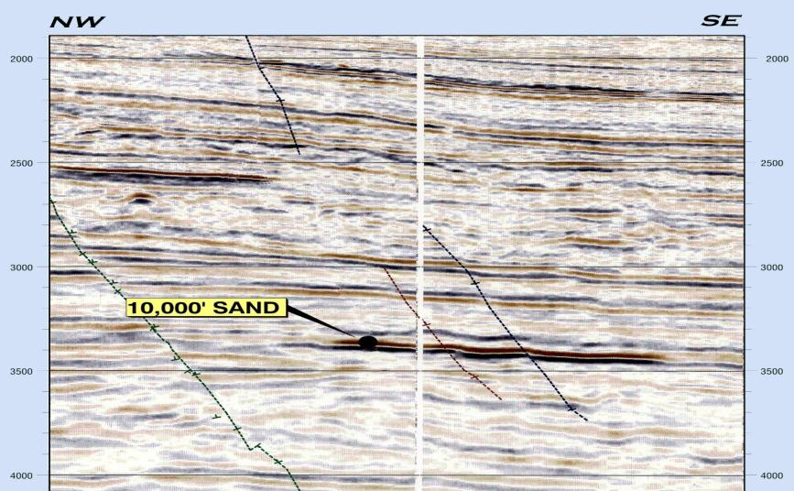
MISSISSIPPI CANYON BLOCK 161 SEISMIC LINE

Slide 65
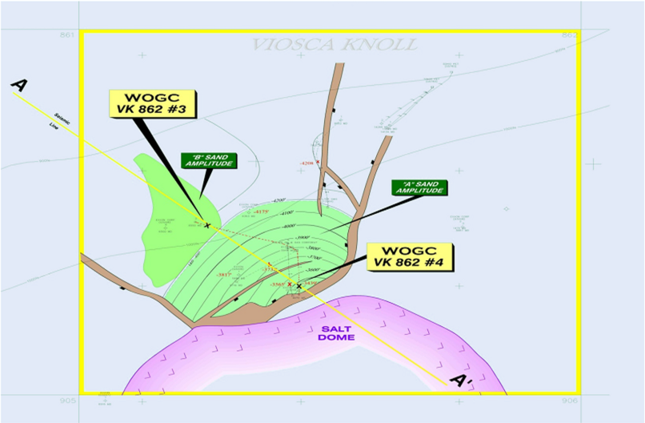
VIOSCA KNOLL BLOCK 862 STRUCTURE MAP

Slide 66
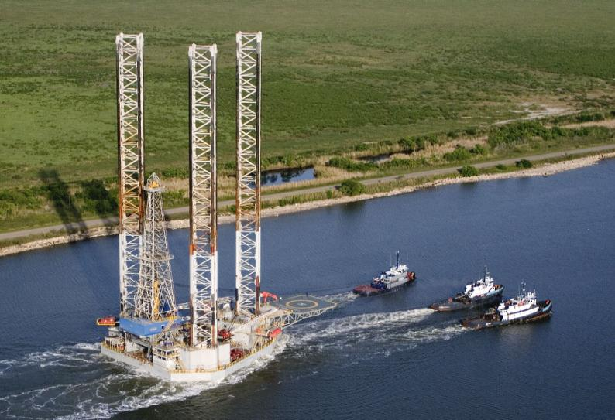
Noble Drilling’s Jack Up Drilling Rig

Slide 67
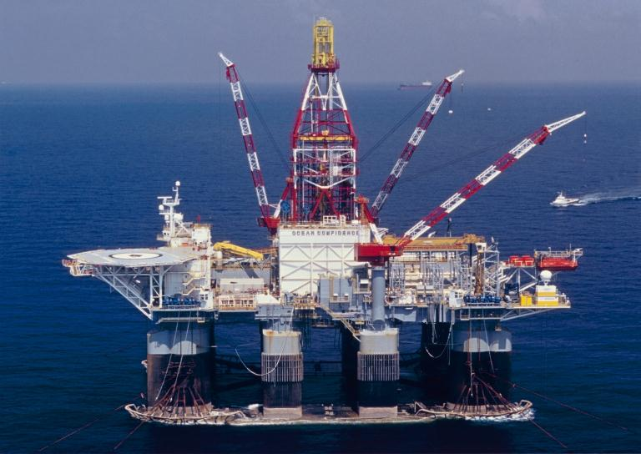
Diamond Offshore’s Semi-Submersible Drilling Rig

Slide 68
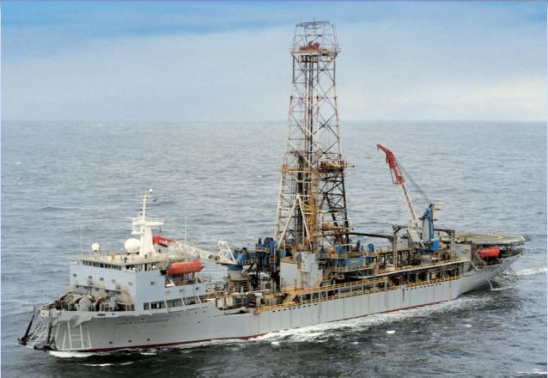
Noble Drilling’s Leo Segerius Drillship

Slide 69
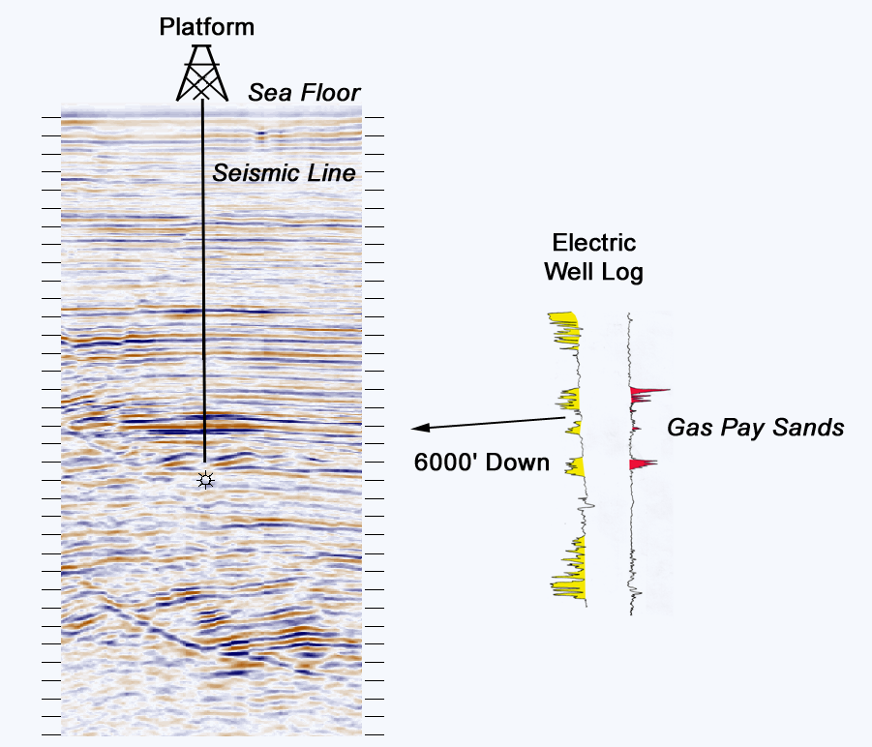
Seismic Line and Well Log Offshore Oil & Gas Field

Slide 70
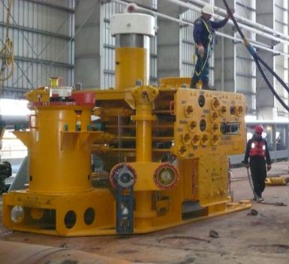
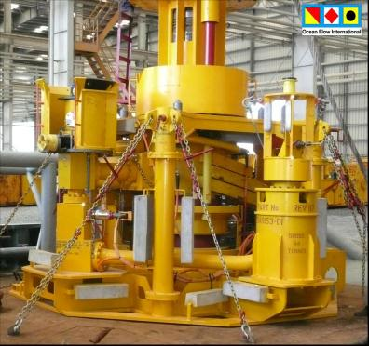
Subsea Trees

Slide 71
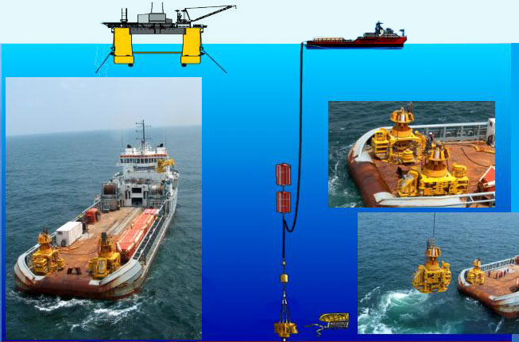
Subsea Tree Deployment

Slide 72
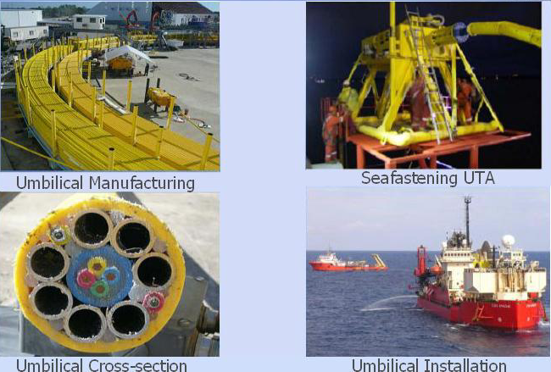
Umbiical System

Slide 73
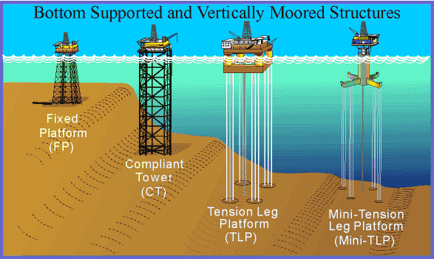
Deepwater Development Systems

Slide 74
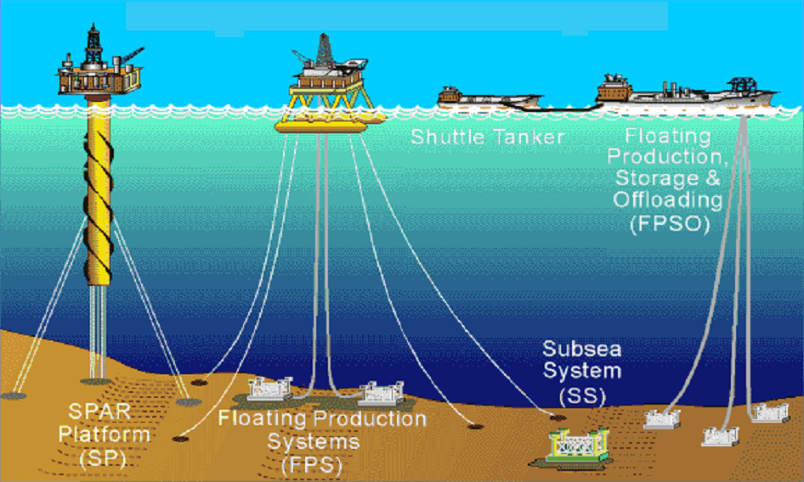
Floating Production and Subsea Systems

Slide 75

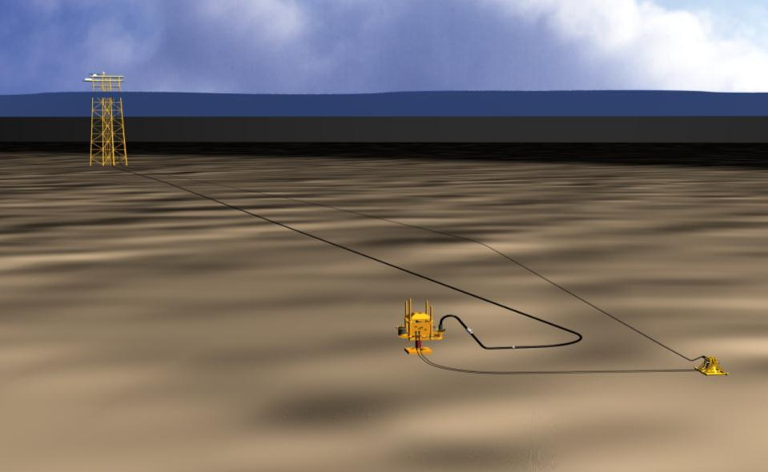
Shelf Tieback to Platform
Apache Corporation’s Ochre Project
Mississippi Canyon 66
Taylor Platform
MC 20
475’ WD
7.8-MILE
3 1/2” FLOWLINE
CONTROL UMBILICAL
SUBSEA TREE
MC 66
1,147’ WD
FLYING LEADS
UMBILICAL
TERMINATION
ASSEMBLY

Slide 76
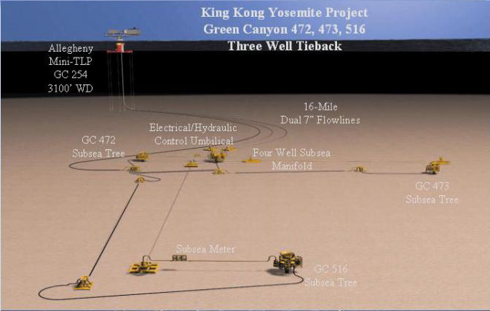
Tieback to Mini-TLP

Slide 77
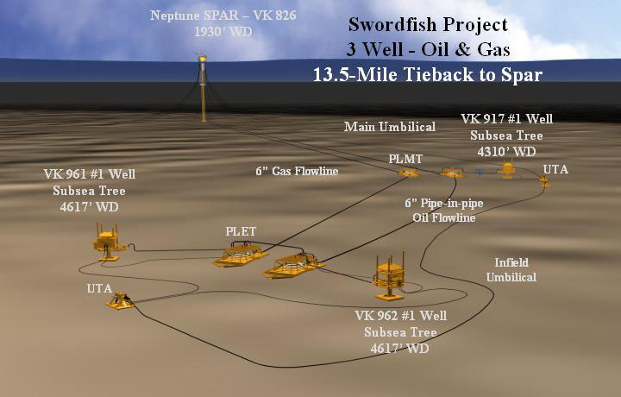
Oil & Gas Tieback to SPAR

Slide 78
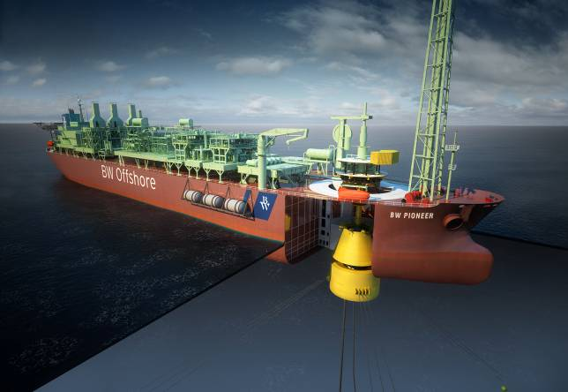
The First FPSO in the Gulf of Mexico
Petrobras Equipment:
Built by BW Offshore for the exclusive use of Petrobras

Slide 79
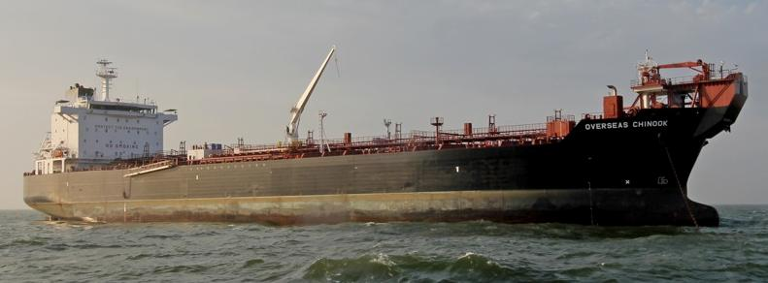
The Overseas Chinook
One of two shuttle tankers on contract with Petrobras that hauls crude from the FPSO to the beach.

Slide 80
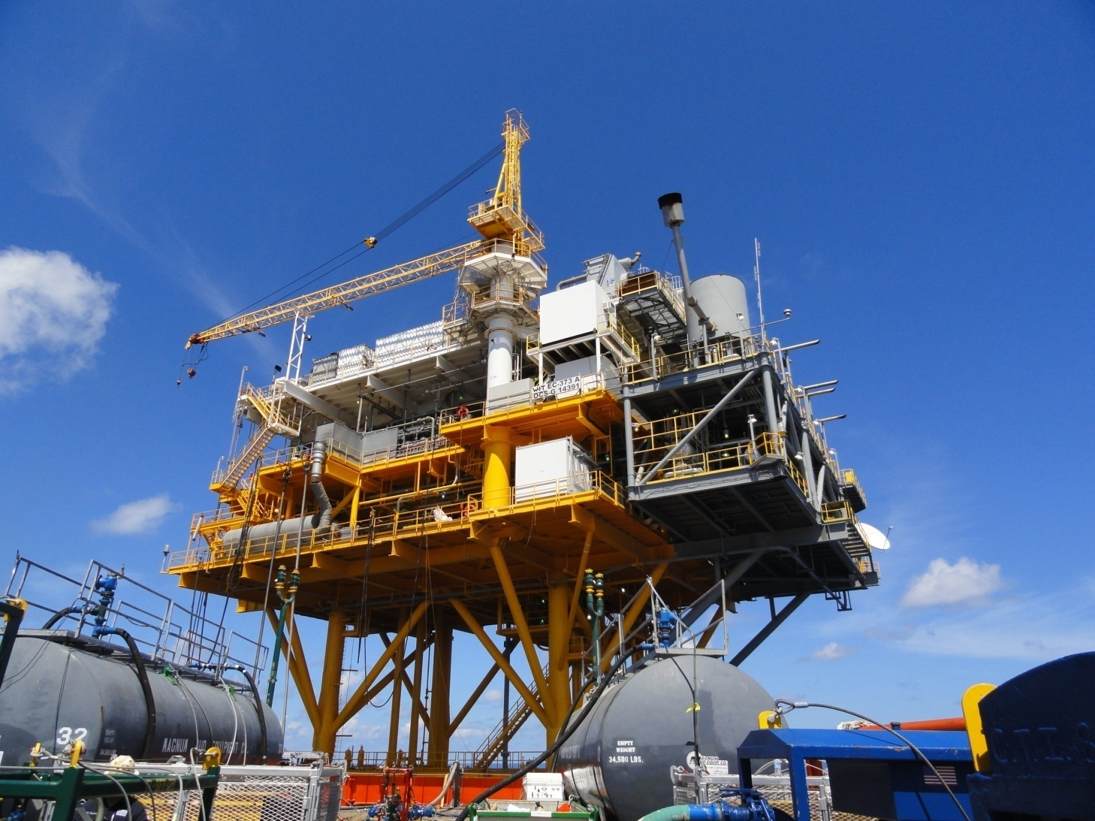
Host Platform for the Cottonwood Field
Cottonwood was the first Petrobras operated project in the Gulf of Mexico.

Slide 81
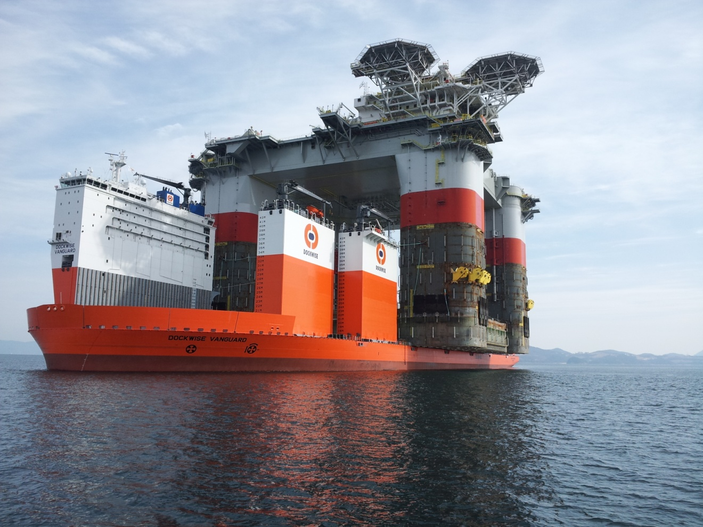
Host Facility for the St. Malo Field
Photo is of host in transit from South Korea to the Gulf of Mexico.
Petrobras is a working interest owner in the project.

Slide 82
To Learn more about the OCS Oil & Gas, or Petrobras:
http://www.ocsadvisoryboard.org/
http://www.api.org/
http://www.boem.gov/
http://www.bsee.gov/
http://statistics.onrr.gov/Default.aspx

Slide 83
THE END

